Slide 1

The Transformer

Slide 2
Prediction Layer
Attention Layer
Encoder
Sentence Embedding
Decoder
Padded Input Sequences
Seq2Seq Model with Attention
Padded Target Sequences

Slide 3
Prediction Layer
Attention Layer
Encoder
(LSTM)
Sentence Embedding
Decoder
(LSTM)
Padded Input Sequences
Padded Target Sequences
Uses LSTM to understand Sequences
Seq2Seq Model with Attention

Slide 4

What is the key issue in working with LSTM?
LSTM processes information sequentially
and can not take advantage of parallel processing available in GPU.
Hence they are quite slow to train in general.

Slide 5
Attention Is All You Need
https://arxiv.org/abs/1706.03762
Moving away from LSTM

Slide 6
Prediction Layer
Attention Layer
Padded Input Sequences
Encoder
(with Dense Layers)
Decoder
(with Dense Layers)
Padded Target Sequences
Transformer Model

Slide 7
How does Encoder understands the sequence?
It tries to understand the Sequence using
Self Attention.

Slide 8

Self Attention vs LSTM
Let’s consider an example e.g. out input sentence is ..
Siddharth played football and he scored a goal

Slide 9
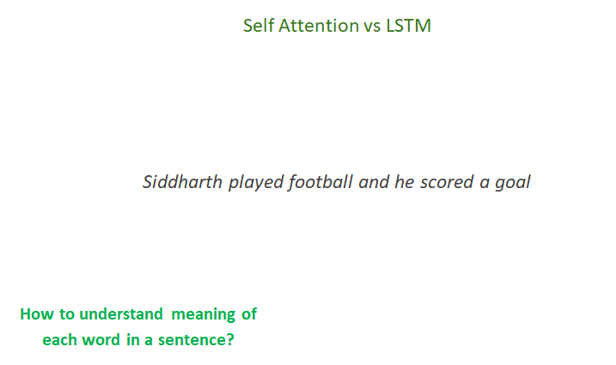

Slide 10
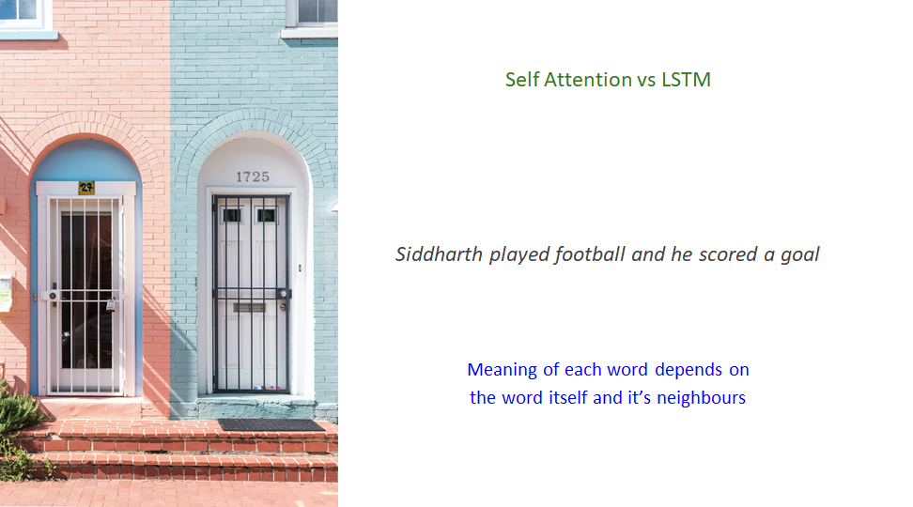

Slide 11
Knowledge of ‘and’ with context of ‘Siddharth’, ‘played’, ‘football’
Knowledge of ‘he’ with context of ‘Siddharth’, ‘played’, ‘football’, ‘and’
Knowledge of ‘scored’ with context of ‘Siddharth’, ‘played’, ‘football’, ‘and’, ‘he’
Knowledge of ‘goal’ with context of ‘Siddharth’, ‘played’, ‘football’, ‘and’, ‘he’,’scored’
Knowledge of ‘football’ with context of ‘Siddharth’, ‘played’
Knowledge of ‘played’ with context of ‘Siddharth’
Knowledge of ‘Siddharth’
H₁
H₂
H₃
H₄
H₅
H₆
H₇
H₀
LSTM
LSTM
LSTM
LSTM
LSTM
LSTM
LSTM
C₀
Siddharth
played
football
and
he
scored
goal
LSTM looks at Sequence one step at a time!!!
LSTM builds a memory (hidden and cell state) as it’s new data elements in the sequence. This allows LSTM to understand individual data elements e.g words based on the context.

Slide 12
How do we get ‘hidden state’ type of information in Transformer Encoder?
We will need to accomplish the same without ‘memory’

Slide 13
Think of this representation as H₁ in LSTM
Self Attention
Knowledge of ‘Siddharth’ and all the context
Siddharth
played
football
and
he
scored
goal
To create encoding for the word ‘Siddharth’, Self attention looks at all the words in the sequence.

Slide 14
Think of this representation as H₂ in LSTM
Self Attention
Knowledge of ‘played’ and all the context
Siddharth
played
football
and
he
scored
goal
To create encoding for the word ‘played’, Self attention looks at all the words in the sequence.

Slide 15
Self Attention
Knowledge of ‘he’ and all the context
Siddharth
played
football
and
he
scored
goal
Great news!!!
Encoding for each word the sequence can be done in parallel.

Slide 16
In Transformer model, Encoder is made up of two type of layers
Feed Forward Network
(Fully Connected)
Encoder
(with Dense Layers)
Self Attention
Understanding Encoder
Transformer Model
Embeddings

Slide 17

Implementing
Self Attention

Slide 18
Implementing
Self Attention
Score for each word involves dot product of query vector of the word with key vectors of all the words in the sentence
Scores for each word
?
?
?
Values Vector
v₁
v₂
v₃
For each word, 3 vectors are created using the embedding as input. These vectors are created using 3 different Dense layers
Key Vector
k₁
k₂
k₃
Query Vector
q₁
q₂
q₃
Embedding
X₁
X₂
X₃
Embedding is created for each word
Input Sentence
Who
is
Tendulkar

Slide 19
Scores for each word
q₁ x k₁
q₁ x k₂
q₁ x k₃
Dot product of query vector of 1st word and key vector of each word in the sentence.
Values Vector
v₁
v₂
v₃
Key Vector
k₁
k₂
k₃
Query Vector
q₁
q₂
q₃
Calculating Self Attention for 1st word
Embedding
X₁
X₂
X₃
Input Sentence
Who
is
Tendulkar

Slide 20
Self Attention vector
z₁
Self Attention vector for 1st word is sum of all the vectors in the previous step
Softmax x Values Vector
Values for each word are multiplied with respective softmax score
Softmax of normalized score
0.01
0.0
0.99
Softmax provides relative importance of each word for 1st word
Normalized Score
4
3.5
9
Scores are divided by square root of length of key vector e.g 8 (square root of 64)
Scores for each word
q₁ x k₁ = 64
q₁ x k₂ = 44
q₁ x k₃ = 40
Dot product of query vector of 1st word and key vector of each word in the sentence.
Values Vector
v₁
v₂
v₃
Key Vector
k₁
k₂
k₃
Query Vector
q₁
q₂
q₃
Calculating Self Attention for 1st word
Embedding
X₁
X₂
X₃
Input Sentence
Who
is
Tendulkar

Slide 21
Self Attention vector
Z₁
Z₂
Z₃
Repeat the process to calculate Self Attention vector for all words
Self Attention Layer
Embedding
X₁
X₂
X₃
Input Sentence
Who
is
Tendulkar

Slide 22
Encoder Embedding
r₁
r₂
r₃
Encoder
Feed Forward Network
Self Attention vector
Z₁
Z₂
Z₃
Building Encoder Embeddings from Self Attention vectors
Self Attention Layer
Embedding
X₁
X₂
X₃
Input Sentence
Who
is
Tendulkar

Slide 23
Encoder Embedding
r₁
r₂
r₃
Feed Forward Network
Encoder uses multiple Self-Attention layers each with its own Key, Query and Values vector
Self Attention vector
Z₁
Z₂
Z₃
Self Attention Layer
Self Attention Layer
Self Attention Layer
Self Attention Layer
Both Self-Attention and Feed Forward network use skip connections with ‘Add & Normalize’ operations.
Embedding
X₁
X₂
X₃
Input Sentence
Who
is
Tendulkar

Slide 24
Both Encoder and Decoder have Self Attention and Feed Forward layers. Decoder has ‘Encoder-Decoder Attention’ layer additionally
Prediction Layer
Feed Forward Network
Feed Forward Network
Encoder-Decoder Attention
Decoder
Input Sequences
Embeddings
Multi-Head Self Attention
Multi-Head Self Attention
Encoder
Target Sequences
Embeddings
Transformer Model

Slide 25
Transformer Model
An Indian Cricketer
Prediction Layer
Encoder # 6
Decoder # 6
Encoder # 5
Decoder # 5
A transformer usually have multiple Encoders and multiple Decoders.
Encoder # 4
Decoder # 4
Encoder # 3
Decoder # 3
Decoder
Encoder # 2
Decoder # 2
Encoder # 1
Decoder # 1
Input Sequences Embeddings
Target Sequences Embeddings
Who is Tendulkar

Slide 26

Different Models built using Transformer architecture

Slide 27
GPT
Transformer XL
BERT
RoBerTa
ALBERT

Slide 28

BERT
Bi-directional Encoder representations from Transformers

Slide 29
Prediction Layer
Encoder # 6
Decoder # 6
BERT
Encoder # 5
Decoder # 5
… only involves Encoders.
Encoder # 4
Decoder # 4
Encoder # 3
Decoder # 3
Decoder
Encoder # 2
Decoder # 2
Encoder # 1
Decoder # 1
Input Sequences Embeddings
Target Sequences Embeddings

Slide 30
How do we train BERT?
With tons of data but in Self-Supervised way

Slide 31
How BERT is trained in Self-Supervised way?
Masked Language Modeling (MLM)
Next Sentence Prediction

Slide 32
I went to store.
Encoder # 6
BERT
Encoder # 5
Up to 15% words in the input sequence are masked.
Model is expected to predict masked word(s).
Masked Language Modeling
Encoder # 4
Encoder # 3
Encoder # 2
Encoder # 1
I [Mask] to store.

Slide 33
True
Encoder # 6
BERT
Encoder # 5
Feed two sentences to the model
Model will predict if 2nd sentence should follow 1st sentence.
Next Sentence Prediction (NSP)
Encoder # 4
Encoder # 3
Encoder # 2
Encoder # 1
1. The man went to a store.
2. He bought 2 litres of milk.

Slide 34
Transfer Learning using BERT
Speeding up NLP Model training

Slide 35
Sentence Classification using BERT
Trained BERT Model
Positive
Movie was awesome . . .
Classification Layers
Negative
With pre-trained BERT, classification model needs to be trained for very few iterations (as los as 2 iterations) to get state of the art results.

Slide 36
How do we try BERT and other Transformer models?
HuggingFace transformers
https://github.com/huggingface/transformers

